Slide 1



AI Workshop 2: Building an ML Pipeline Tuesday 3rd February 2025
Omar Choudhry

Slide 2

Learning Objectives
By the end of this lesson, you will learn:
What are the different types of machine learning (ML) models?
What is data and data pre-processing?
How can we use prompt engineering to help us write code?
What is an ML pipeline, and how can we use it to build AI?

Slide 3
Recap of Machine Learning
Machine learning: algorithms which learn patterns in data to make predictions

Slide 4



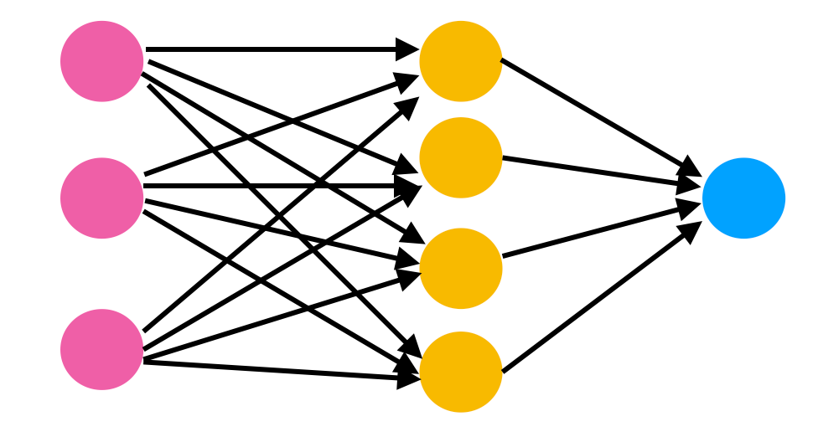
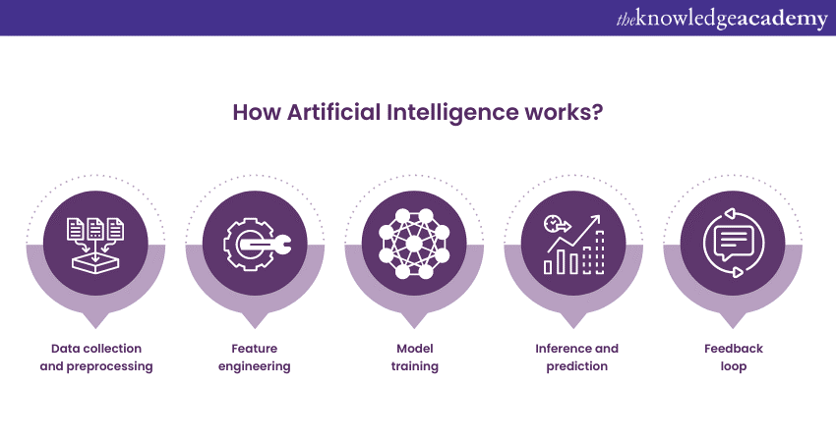
Recap of Machine Learning

Slide 5
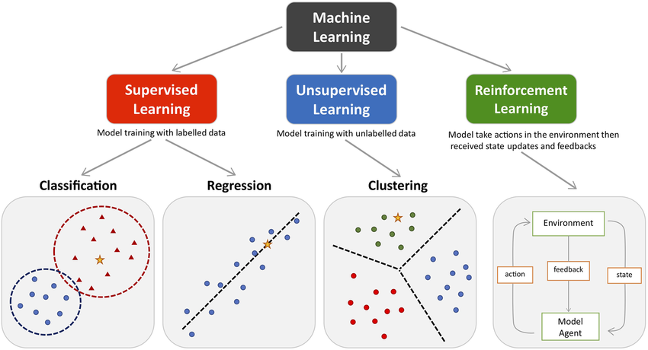
Types of ML Models

Slide 6
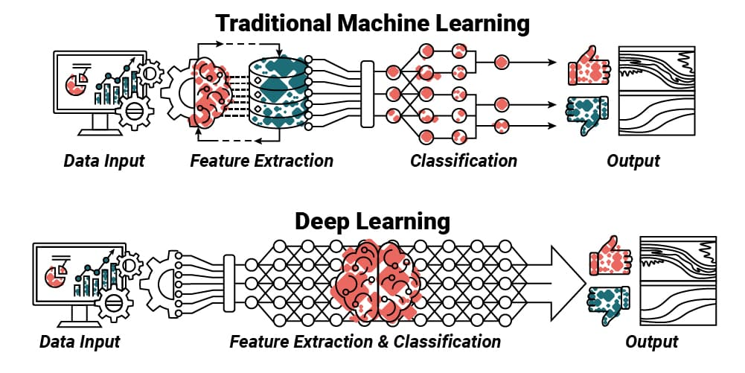
Types of ML Models

Slide 7
Types of Data
Numbers (Discrete, Continuous)
Image (Table with Rows and Columns of Pixels)
Video (Sequences of images)
Text (Ordinal, Nominal, Free-Text)
Audio (Constantly changing sound waves)

Slide 8
Data Preprocessing
Numbers (Discrete, Continuous)
Image (Table with Rows and Columns of Pixels)
Video (Sequences of images)
Text (Ordinal, Nominal, Free-Text)
Audio (Constantly changing sound waves)

Slide 9
Prompt Engineering
Pick a suitable Large Language Model (LLM) (Gemini is integrated in Google Colab)
Give detailed instructions (e.g. Explain to me like I’m a 5 year old… Use comments throughout to explain your thought-process… etc.)
Try to understand the purpose of each line of code, even if you don’t understand the syntax

Slide 10
Let’s Build an ML Pipeline
Google Colab: https://colab.research.google.com/

Slide 11



Feedback
Contact
Slides are available at github.com/omariosc/ai-workshops
O.Choudhry@leeds.ac.uk
Feedback Form
WhatsApp Community Chat

